Slide 1
LAN Connections
Using a Cisco Router as a DHCP Server

Slide 2
Understanding DHCP
  DHCP is built on a client-server model, as follows:
    The DHCP server hosts allocate network addresses and deliver configuration parameters.
    The term "client" refers to a host requesting initialization parameters from a DHCP server.
  DHCP supports these three mechanisms for IP address allocation:
    Automatic allocation; DHCP assigns a permanent IP address to a client.
    Dynamic allocation; DHCP assigns an IP address to a client for a limited period of time.
    Manual allocation; A client IP address is assigned by the network administrator, and DHCP is used simply to convey the assigned address to the client.
  Dynamic allocation is the only that allows automatic reuse of an address that is no longer needed by the client to which it was assigned.

Slide 3
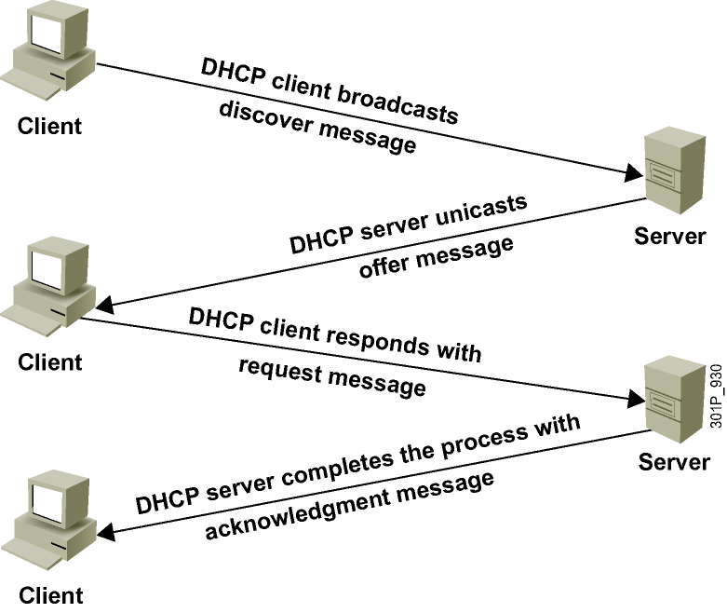
DHCP

Slide 4
Using a Router as a DHCP Server
Cisco IOS Software includes a full DHCP server implementation:
  Assigns IP addresses from specified address pools within the router
  Can be configured to assign the IP address of these components:
    Domain Name System (DNS) server
    Default router

Slide 5
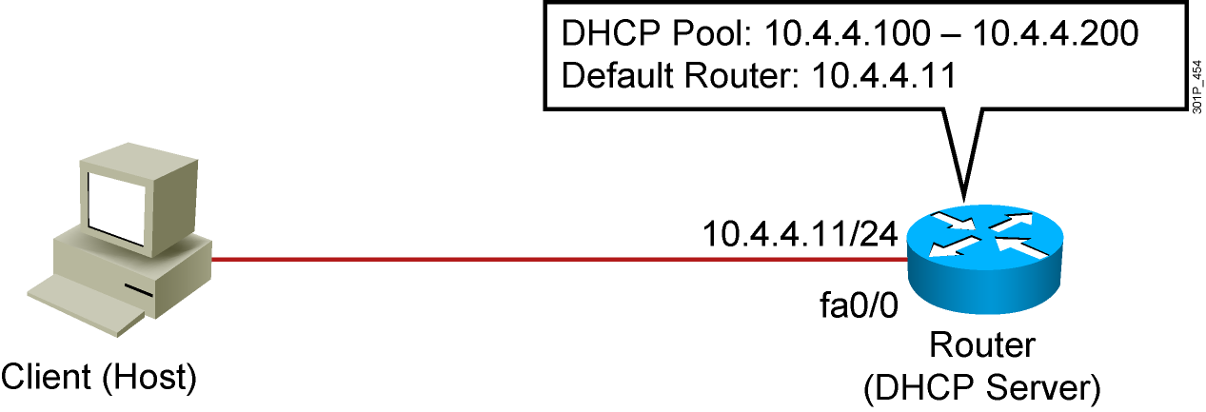
DHCP Server Using a Router

Slide 6
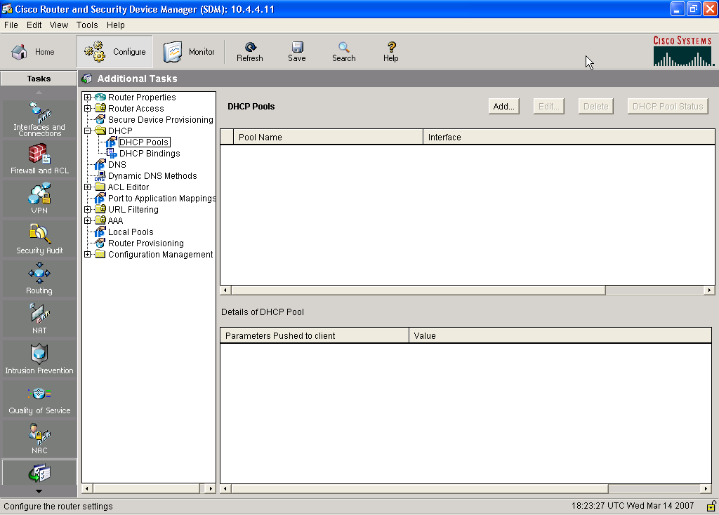
Additional Tasks

Slide 8
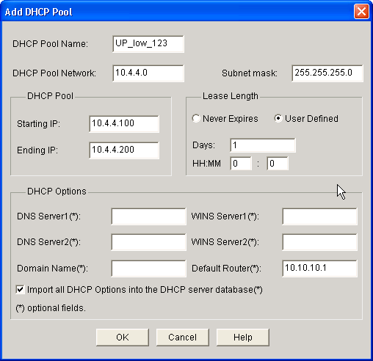
DHCP Pool

Slide 10
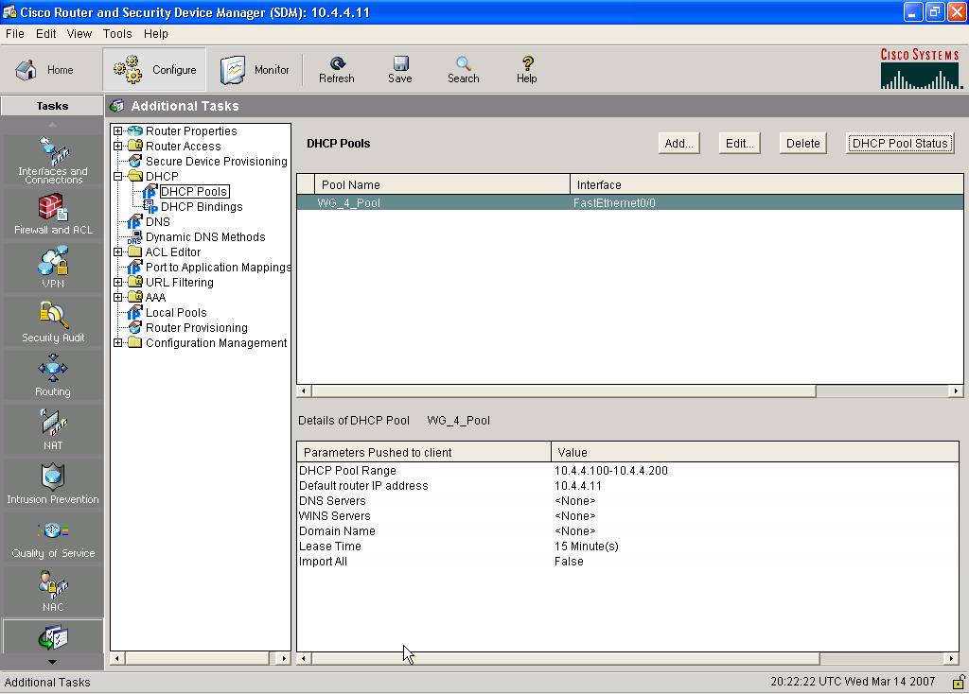
Checking the DHCP Configuration

Slide 12
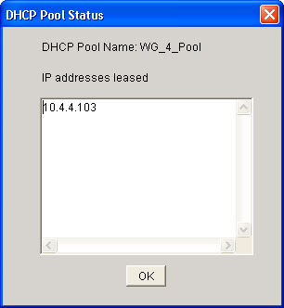
DHCP Pool Status

Slide 14
show ip dhcp conflict
RouterX# show ip dhcp conflict
IP address Detection Method Detection time
172.16.1.32 Ping Feb 16 2007 12:28 PM
172.16.1.64 Gratuitous ARP Feb 23 2007 08:12 AM

Slide 15
Summary
  DHCP is built on a client-server model.
  DHCP server hosts allocate network addresses and deliver configuration parameters.
  Cisco IOS Software includes a DHCP server.
  Cisco SDM can be used to configure a DHCP server on a router.
  The required configuration items are as follows:
    Pool name
    Pool network and subnet
    Starting and ending addresses
  Cisco SDM can be used to monitor a DHCP server on the router.
  The show ip dhcp conflict command can be used to find conflicts.

